Slide 2

OVERVIEW
WHAT IS GIT
HOW GIT WORKS
GIT INSTALLATION
GIT CONFIGURATION
BASIC COMMANDS
BRANCH & MERGE
DEMO & VEDIO
QUESTIONS

Slide 3
WHAT IS GIT
GIT is an open source version control system.
Unlike older centralized version control systems such as SVN and CVS, GIT is distributed; every developer has the full history of their code repository locally.

Slide 4
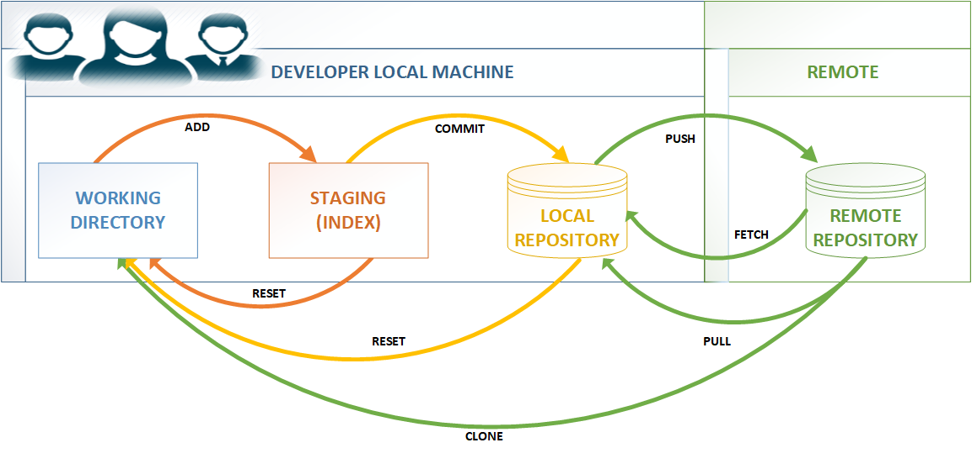
HOW GIT WORKS

Slide 5
HOW GIT WORKS
GIT consists of two types of repositories - Remote & Local
Local repositories are copies of code which are managed on your private machine
Remote repositories are copies of code that are shared on servers visible to entire teams
Developers will work with Local repository & then push their changes to the Remote repository

Slide 6
GIT INSTALLATION
Download Git from below URL for windows
https://git-scm.com/download/win
It’s straight forward installation. If required kindly refer below documents.

Slide 7
GIT CONFIGURATION
git config --list
git config --global user.name “Name"
git config --global user.email test@example.com
git config --global http.sslVerify false

Slide 8
BASIC COMMANDS
git init → Create an empty Git repository or reinitialize an existing one.
git clone → Create a local copy of a project that already exists remotely. The clone includes all the project’s files, history, and branches. We can clone using ssh/https.
git checkout → Checkout command lets you navigate between the branches branch.
git pull → Fetches the files from the remote repository and merges it with your local one.
git fetch → Command used to downloads commits, files, and refs from a remote repository into your local repo. but it doesn’t force you to actually merge the changes into your repository.

Slide 9
BASIC COMMANDS
git status → command displays the state of the working directory and the staging area
git add . → command adds a change in the working directory to the staging area
git commit → command captures a snapshot of the project's currently staged changes
git push → command is used to upload local repository content to a remote repository
git reset → command that is used to undo local changes to the state of a Git repo

Slide 10
BRANCH & MERGE
Why we need branch?
If you are creating a new feature for your project, there's a reasonable chance that adding it could break your working code
git branch <branch name> → create new branch into local repository
git branch -a → List all the branches in your repo.
git branch -d <branch name> → Delete the branch on local repository
git push origin : <branch name>→ Delete a branch on remote repository
Merging is a common practice for developers using version control systems. Whether branches are created for testing, bug fixes, or other reasons, merging commits changes to another location.
git checkout <branch name>
git merge <branch name>

Slide 11
Branching & Merging
Current DEV branch
v1_dev
”DEV” branch ” merges into release branch ONLY
v1_rel
”REL” branch ” merges into PROD branch ONLY
Create ALL New Branches from ”latest PROD”
R1.0.0
R1.1.0
R1.1.1
consignment-g2-sca_prod/MASTER
This is a ”PROD mirror” branch
FIX
FIX
MAINTENANCE team branch for V1 DEV PROD changes
v1_rmaint

Slide 12
TAG & REMOTE
Tag are ref's that point to specific points in Git history. Tagging is generally used to capture a point in history that is used for a marked version release (i.e. v1.0.1)
git tag <tag name> → create tag
git tag → list all the tags
git show <tag name> → show the history of the tag
A remote in Git is a common repository that all team members use to exchange their changes. In most cases, such a remote repository is stored on a code hosting service like GitHub
git remote -v → List all currently configured remote repositories
git remote add origin <server> → want to connect repository to a remote server

Slide 13
IKEA INTERGRATION CM RULES
Braching naming standared
Commit message standared
Active branches(DEV, REL, MAINT & PROD)
When we need to create new git repository
When multiple development branch should be active
When to create tag
CM roles & responsibility (Compilation, Code verification, repository list, user access, commit message standard, etc)

Slide 14


VIDEO DEMO
Command-line Video Tutorial

Slide 15
VIDEO DEMO
Tortoise GIT Video Tutorial

Slide 16
QUESTIONS?

